Slide 1
XPages Goes Relational
=
Philippe Riand - IBM

Slide 2
Note: Information regarding potential future products is intended to outline our general product direction and it should not be relied on in making a purchasing decision. The information mentioned regarding potential future products is not a commitment, promise, or legal obligation to deliver any material, code or functionality. Information about potential future products may not be incorporated into any contract. The development, release, and timing of any future features or functionality described for our products remains at our sole discretion.

Slide 3

Relational Database Roadmap
Next Release
- Enhancements based on user feedback
- Eventually makes a Feature Pack? (to be evaluated)
Update 1 – Fall 2011
Initial Release – Summer 2011
- Enhancements based on user feedback
- Better Designer integration using WDT tooling (Sql & connection editor, Data binding helpers...)
2012
- Delivered on openNTF, as part of the extension library
- Runs on top of Domino 8.5.3
- JDBC Connection Manager
- New Read and Read/Write data sources
- Integration with the existing controls (view panel, edit...)
- Java & SSJS JDBC API helpers
2011

Slide 4
XPages Relational Database Support
XPages leverages JDBC to connect to the relational databases
  Accesses any database with a JDBC driver available
    Supports DB2, Oracle, MySQL, SQL Server, Derby... you name it!
    ODBC bridge on Windows
    Get the driver from the database vendor, or a third party provider
  The data is accessed directly: no synchronization needed with NSF
The XPages runtime efficiently manages the connections through a connections pool
  Global or NSF specific connections
  Available using JNDI
The data is accessed using a set of dedicated data sources
JavaScript and Java API helpers are provided for programmatically accessing JDBC

Slide 5
Creating and Consuming Database Connections
XPages uses a connection pool to optimize the use of connections
  Pluggable architecture for different implementations
  Simple connection pool provided, plan to add support of Apache DBCP
The connections can be defined globally (server) or locally (NSF)
  The server can contain resources files, .jdbc, in data/properties, that defines the connections (one file=one connection).
  A NSF contains a new file design element identical to the global resources files for defining database specific connections
  Connections can also be contributed programmatically via an extension point
The XPages runtime ensures that the a connection is properly closed when an XPages request finishes

Slide 6
JDBC Connection File (*.jdbc)
Defines the parameters of the connection
The name of the file defines the name of the connection
  {name}.jdbc is exposed as jdbc/{name} by JNDI
Files can contain references to properties with the ${...} syntax
  Ex: Derby URL that accesses a database located in the workspace
  jdbc:derby:${rcp.data}\derby\XPagesJDBC;create=true

Slide 7
Contributing Drivers
Standard JDBC install (see DriverManager JavaDoc)
  Drop the driver jar files in jvm/lib/ext, not recommended
  If you use the connection pool, then the driver is registered when the connection file is loaded, else you have to register it yourself
Drop the driver jar inside the NSF
  Not recommended as each database will load its own copy
  The JDBC driver manager is global and will be confused if 2 databases expose the same driver
  The driver still have to be registered a way or another
Create an OSGi plugin – !Highly recommended!
  The plug-in contains the Jar files along with an implementation of an extension point provided by the XPages runtime
    Automatic registration of the driver
    Best performance provided by a shared driver
    See the provided Derby sample as an example

Slide 8
Derby Driver
A Derby driver is provided for convenience
  Allows the examples to run without having to install an RDBMS, using embedded Derby (serverless)
  Shows how a driver can be contributed to the runtime
This is not intended to be run on a production server
  Although convenient, Derby does not perform as good as native databases (DB2...)

Slide 9
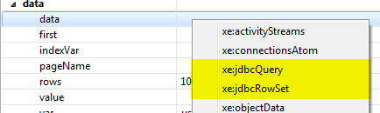
Relational Data Sources
Several data sources are exposed, depending on the needs
  Read only data source (jdbcQuery)
    Directly uses JDBC result sets and optionally maintains a cache
      Handles very large data sets
  Read/write data source (jdbcRowSet)
    Uses a JDBC CachedRowSet , getting the whole data set
      The bigger the data set is, the more memory it uses
    Caches all the changes made to the data until they are committed back to the RDBMS
    Manages updates conflicts using a custom Java conflict handler

Slide 10
SQL Queries
The SQL query can be provided using either
  A table name – The runtime will generate a select * from <table name>
  A SQL query, from a data source property (static or computed)
  A SQL file resource (*.sql) containing the SQL statement
The size of the result set can be computed so the pager can display the actual number of pages
  Enabled using the calculateCount property, which is false by default
  Generates a hidden select count(*) to get the exact size
    Just replaces the select part of the original query by count(*)
    A specific count query can be provided for performance reasons (ex: avoid ordering...)

Slide 11



Parameterizing Data Sources
A data source can either point to a named connection or a JDBC URL
  Named connections are heavily advised as they take advantage of a connection pool, and they are easier to manage as they are centrally defined
    The JNDI prefix can be omitted in the name
  JDBC URL are for debugging purposes only
The SQL statement can either be defined (or computed) from a data source property, or defined in a separate file design element (*.sql)
Parameters, matching the '?' in the SQL query, are also defined at the data source level. The order of the parameters must match the order of '?' in the SQL query
sqlTable: a simple table name
sqlQuery: a general sql query
sqlFile: points to a .sql design element

Slide 12

JDBC Query Data Source
Caches the SQL result into blocks of memory
  By default, the # of cached blocks is 0, but can be increased particularly if the DB connection is slow (maxBlockCount)
Automatic computation of the count when necessary (use of Pagers)
Support the reorder of a query by generating an order by statement
  The default “order by” of the query is isolated in a specific property (orderBy)
Fully integrated with the data iterators, including the ViewPanel
  Supports paging and the pager control (enable calculateCount to get the actual # of pages displayed)
  Supports column sort through a user action

Slide 13
JDBC RowSet Datasource
Execute a query and caches the entire result in memory
  The number of rows being cached is parameterizable using the maxRows property
  The count is in fact the # of rows in the data source
Allows changes to the data cached, and then a commit of all the changes at once
Uses the standard CachedRowSetImpl class coming with the JRE, but custom classes can also be used

Slide 14
Transactions
By default, the data source auto-commit the changes
A transaction management control is provided to better define the transactional behavior, and to allow multiple data sources to participate to the same transaction

Slide 15
Java & JavaScript API Helpers
Java
  A set of utility methods are provided in the JDBCUtil class
  There is also a package that aims to encapsulate some of the DB specific SQL syntax. See com.ibm.xsp.extlib.jdbc.dbhelper.DatabaseHelper
JavaScript
  Although JavaScript can access any java code, some helpers are provided to easy the use of JDBC
  Extra @function() are available, starting with @Jdbc()
    Provide access to the JDBC connections
    Easy execution of sql statements (@JdbcExecute, @JdbcInsert...)

Slide 16
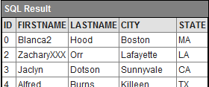
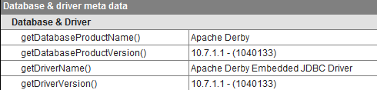
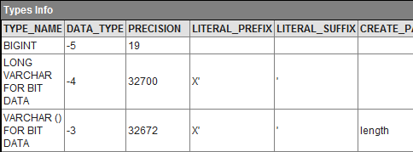
Debugging Relational Data
The Extension Library dumpObject control has a provider for dumping JDBC ResultSets (from SQL queries, meta-data...)

Slide 17
Known Limitations
Only basic SQL types are supported by the data sources
  Blob, Stream, Array, Struct are not supported
  → but they can be used by directly calling the JDBC methods
FileUpload and FileDownload controls cannot be bind to relational data sources
No particular support for JTA and distributed transactions
Apache DBCP is not yet enabled, neither driver specific DataSources
Generated SQL query do escape the table nor the column names

